Slide 1

Dissertation – Week 3
University of Oxford – OMMS
Kim López Güell

Slide 2
What I did this week
Main work: wrote a very detailed research proposal of what and how I am going to do my study
  Read lots of papers to see what has been done
  Searched for data to see what can be done
  Studied statistical methods for Time Series Analysis
  Read about good practices and checks for good behaviour and robustness of the model
Started reading Covid by numbers, Spiegelhalter (2021)
Played a little bit with SLR with R

Slide 3
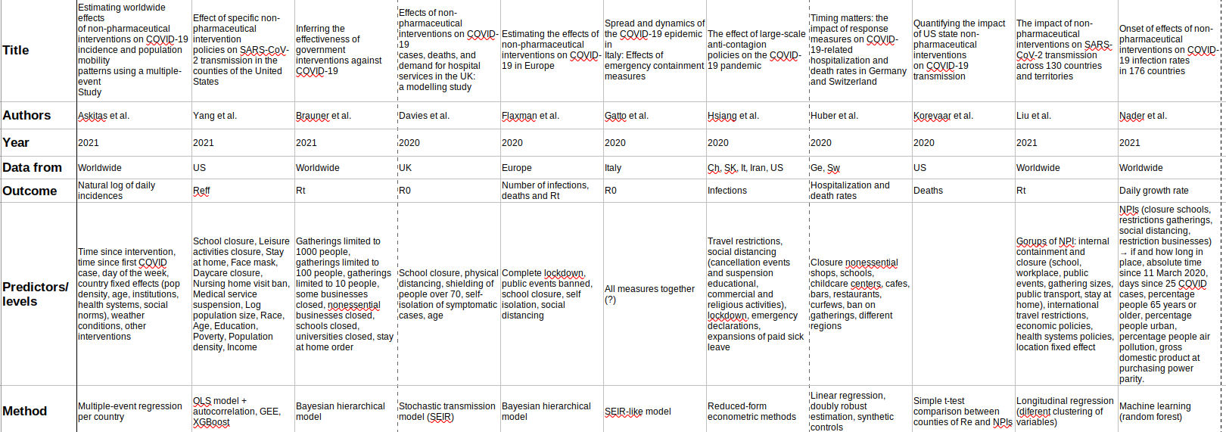
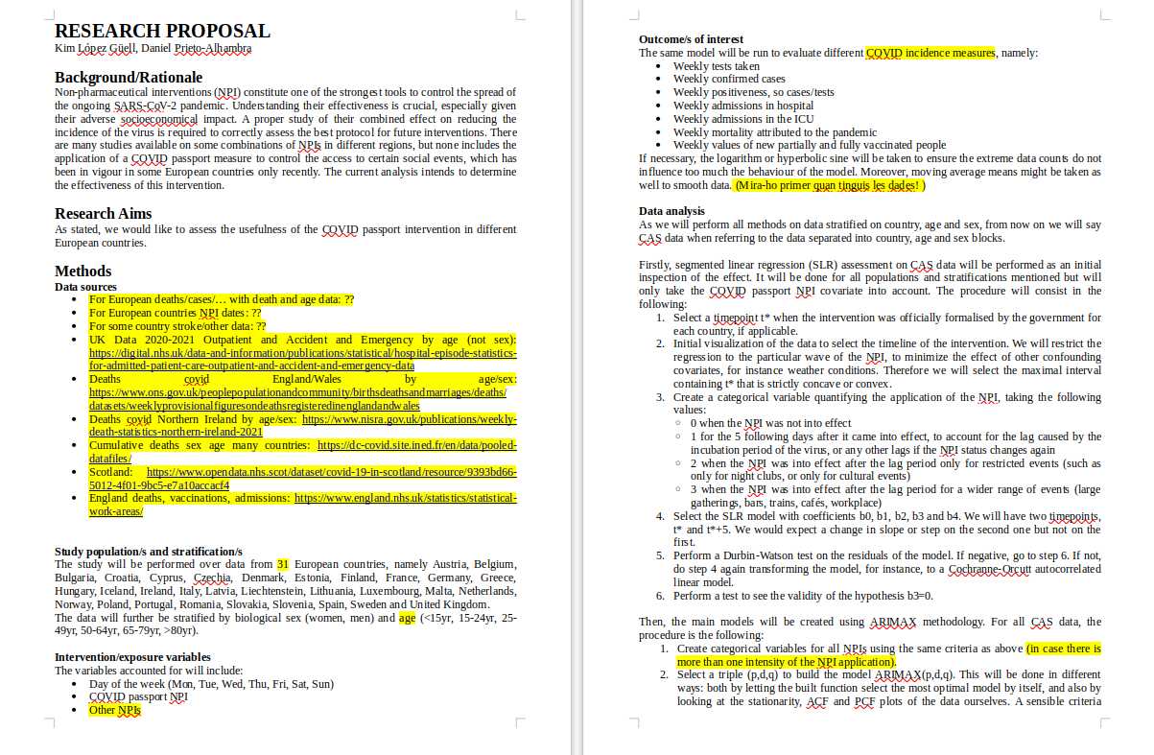
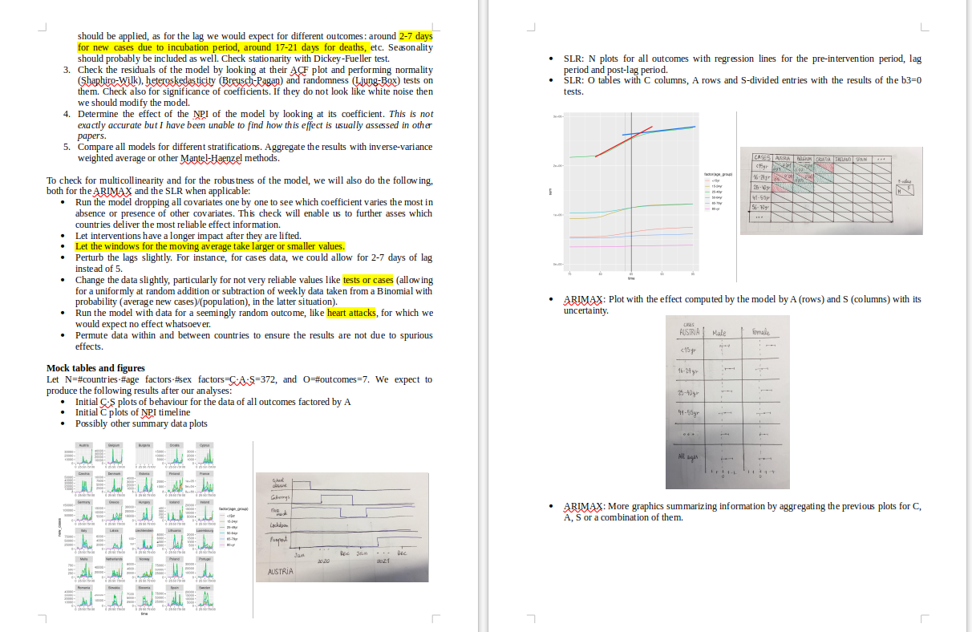
What I did this week
Background/Rationale
Research Aims
Methods: Data source/s, Study population/s and stratification/s, Intervention/exposure variable/s, Outcome/s of interest, Data analysis, Mock tables and figures

Slide 4
What I will do next week
Finish the research proposal, so that what I will actually do is 100% clear and I can start the analysis in Jaunary straight away
Play a little bit more with ARIMAX and SLR with R
Make a final list of where I will download the data from
Finish Covid by numbers, Spiegelhalter (2021)

